Slide 1
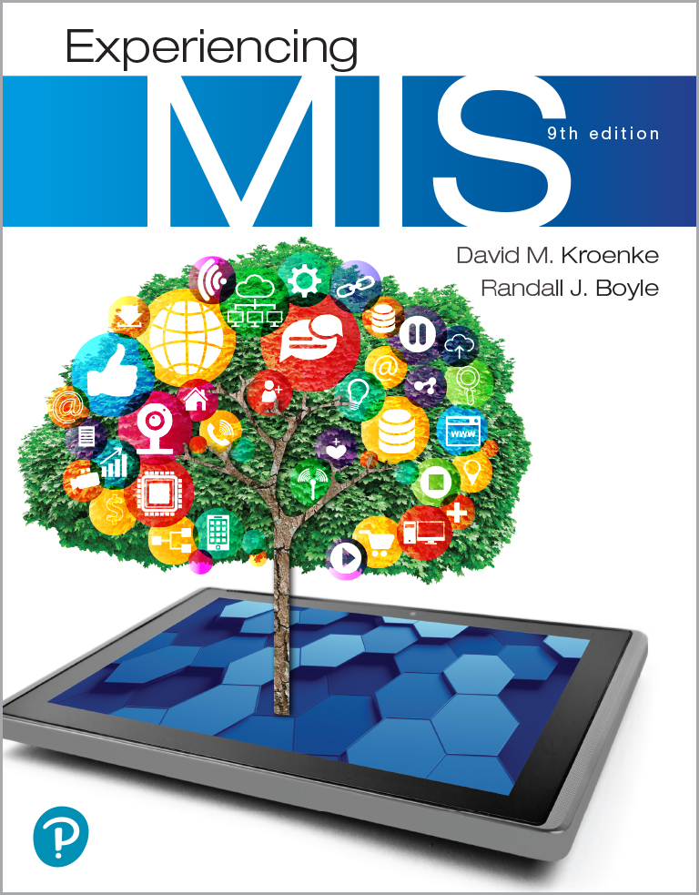
Experiencing M I S
Ninth Edition
Chapter 6
The Cloud
Copyright © 2021, 2019, 2017 Pearson Education, Inc. All Rights Reserved
Notes:
If this PowerPoint presentation contains mathematical equations, you may need to check that your computer has the following installed:
1) MathType Plugin
2) Math Player (free versions available)
3) NVDA Reader (free versions available)
Until about 2010, most organizations constructed and maintained their own computing infrastructure. Organizations purchased or leased hardware, installed it on their premises, and used it to support organizational email, Web sites, e-commerce sites, and in-house applications, such as accounting and operations systems. After 2010, however, organizations began to move their computing infrastructure to the cloud. In the future, nearly all, computing infrastructure will be leased from the cloud.

Slide 2
“How about $10 per Terabyte?”
Lease storage capacity from third party.
All incoming data from drones automatically uploaded.
Average monthly storage costs cut at least 50%.
Power savings, backup time saved, no new hardware configuration.
One-time set up and development costs.
Notes:
Use scenario to:
Illustrate importance (and promise) of the cloud.
See firsthand the benefits of the cloud to business.
Set up a skeptical view of cloud benefits and use that skepticism to motivate the learning of this chapter’s contents.

Slide 3
Study Questions
6-1 Why is the cloud the future for most organizations?
6-2 How do organizations use the cloud?
6-3 How can eHermes use the cloud?
6-4 How can organizations use cloud services securely?
6-5 What does the cloud mean for your future?
Notes:
Business people need the knowledge in this chapter to answer questions like these. In the 21st century, many of your competitors will be able to answer these questions without hiring outside consultants.

Slide 4
Benefits of the Cloud
6-1 Why is the cloud the future for most organizations?
The Cloud
Elastic leasing of pooled computer resources over the Internet.
Elastic
Automatically adjusts for unpredictable demand.
Limits financial risks.
Pooled
Same physical hardware.
Economies of scale.
Notes:
Organizations are moving their computing infrastructure to the cloud. Leasing computing infrastructure from the cloud will become common practice.

Slide 5
Where Did the Cloud Come from? (1 of 2)
6-1 Why is the cloud the future for most organizations?
The Mainframe Era (1960s–1980s)
Large-scale high-speed centralized computers.
Thin clients, no Internet, and no Cloud.
The Client-Server Era (1990s–2000s)
Allowed clients (users) to send requests across the Internet to servers.
Internet, but no modern cloud computing yet.

Slide 6
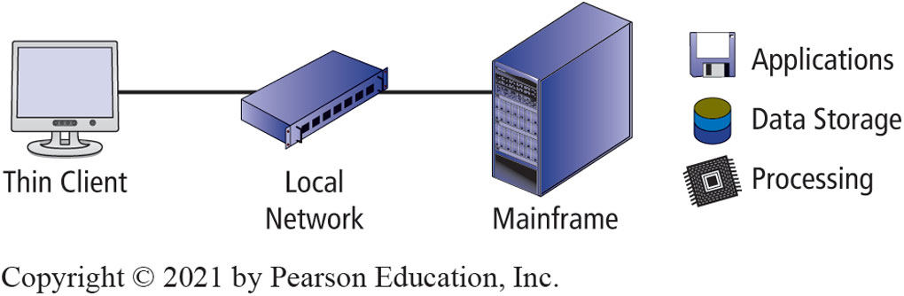
The Mainframe Era (1960s–1980s)
6-1 Why is the cloud the future for most organizations?
Figure 6-1 The Mainframe Era (1960s–1980s)
Notes:
Note the location of applications, data storage, and processing on the mainframe.

Slide 7
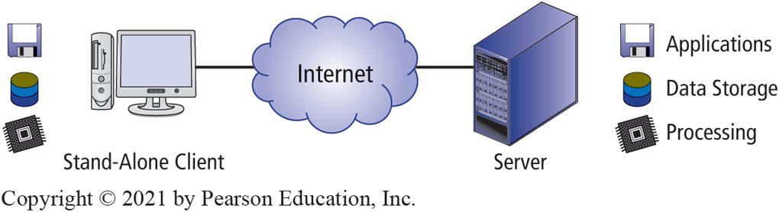
The Client-Server Era (1990s–2000s)
6-1 Why is the cloud the future for most organizations?
Figure 6-2 The Client-Server Era (1990s–2000s)
Notes:
Note the location of applications, data storage, and processing on both the stand-alone client and the server. Point out that the processing load can be shared.

Slide 8
Where Did the Cloud Come from? (2 of 2)
6-1 Why is the cloud the future for most organizations?
The Cloud Computing Era (2008–Current)
Applications, data, and processing power can be used remotely.
Accessed with a variety of devices including P C s, thin clients, mobile devices, and I o T devices.

Slide 9
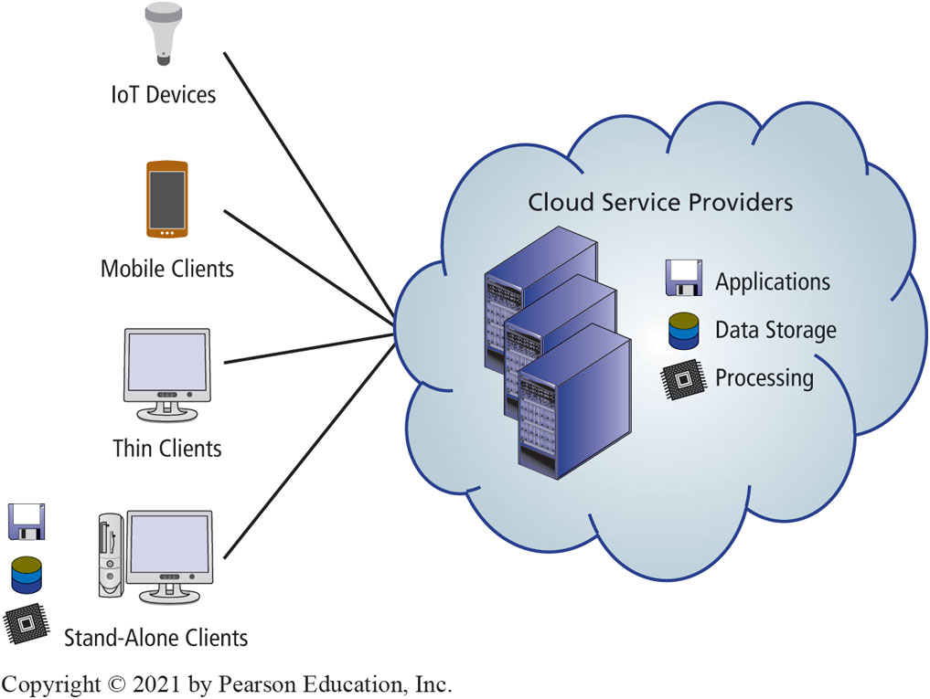
The Cloud Computing Era (2008–Current)
6-1 Why is the cloud the future for most organizations?
Figure 6-3 The Cloud Computing Era (2008–Present)
Notes:
Figure 6-3 shows a simplified Cloud computing architecture. This includes IoT devices, mobile clients, thin clients, stand-alone clients, the Internet, and Cloud service providers.

Slide 10
Why Do Organizations Prefer the Cloud?
6-1 Why is the cloud the future for most organizations?
Lower costs — cheap processors, essentially free data communication and storage.
Ubiquitous access.
Improved scalability.
Elasticity.
Virtualization technology.
Internet-based standards enable flexible, standardized processing capabilities.

Slide 11
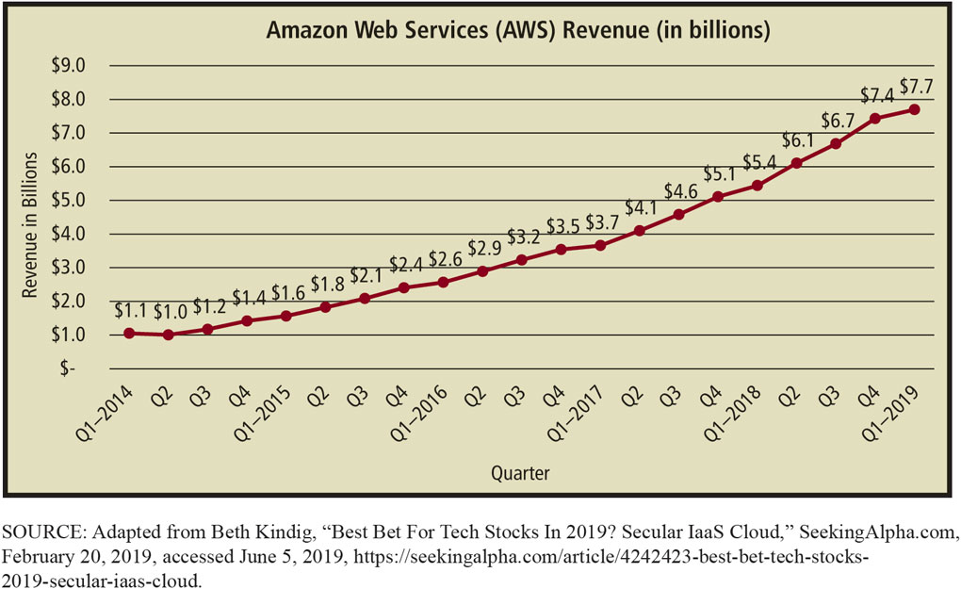
Growth of Amazon Web Services
6-1 Why is the cloud the future for most organizations?
Figure 6-4 A W S Revenue Growth
Notes:
Amazon boasts more than a million active customers! These customers include large companies like Adobe Systems, Netflix Inc., and Pfizer Inc. One million of this type of customer is a lot.

Slide 12
When Does the Cloud Not Make Sense?
6-1 Why is the cloud the future for most organizations?
When law or standard industry practice require physical control or possession of the data.
Financial institutions legally required to maintain physical control over its data.

Slide 13
Why is the Cloud Preferred to In-House Hosting? (1 of 2)
6-1 Why is the cloud the future for most organizations?
Figure 6-5 Comparison of Cloud and In-House Alternatives (continues on next slide)
Positive:
Cloud | In-house
Small capital requirements | Control of data location
Speedy development | In-depth visibility of security and disaster preparedness
Superior scalability to growing or fluctuating demand
Known cost structure
Possibly best-of-breed security/disaster preparedness
No obsolescence
Industry-wide economies of scale, hence cheaper
Focus on core business, not infrastructure
Notes:
Comparison of cloud and in-house alternatives.

Slide 14
Why is the Cloud Preferred to In-House Hosting? (2 of 2)
6-1 Why is the cloud the future for most organizations?
Figure 6-5 Comparison of Cloud and In-House Alternatives (con’t.)
Negative:
Cloud | In-house
Dependency on vendor | Significant capital required
Loss of control over data location | Significant development effort
Little visibility into true security and disaster preparedness capabilities | Difficult (impossible?) to accommodate fluctuating demand
Blank | Ongoing support costs
Blank | Staff and train personnel
Blank | Increased management requirements
Blank | Annual maintenance costs
Blank | Cost uncertainties
Blank | Obsolescence
Notes:
Continuation of Figure 6-5.

Slide 15
Using the Cloud
6-2 How do organizations use the cloud?
Resource Elasticity
A car manufacturer runs an ad during the Academy Awards.
Doesn’t know if there will be a thousand, a million, 10 million, or even more site visits.
Cloud vendor will programmatically increase server capacity.
The car manufacturer reduces costs substantially.

Slide 16
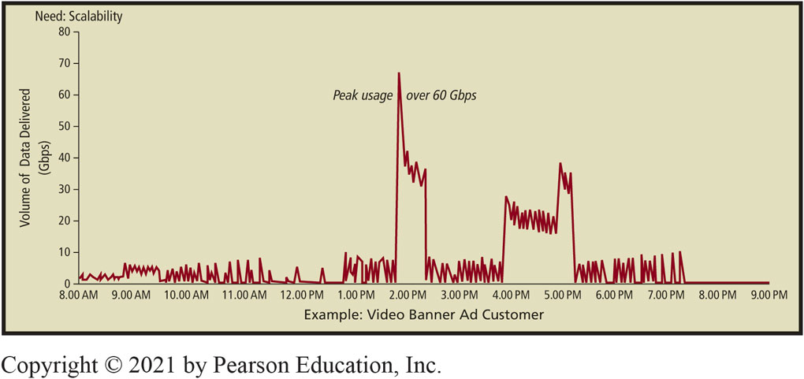
Example of a Video Banner Ad Customer
6-2 How do organizations use the cloud?
Figure 6-6 Example Video Banner Ad Customer
Notes:
Figure based on real case supported by Amazon.com’s CloudFront
Without increase in servers, response time 3 or 5 seconds or more, far too long to maintain attention of viewer.

Slide 17
Pooling Resources
6-2 How do organizations use the cloud?
Economies of scale
Average cost decreases as size of operation increases.
Major cloud vendors operate enormous data centers (Web farms).

Slide 18
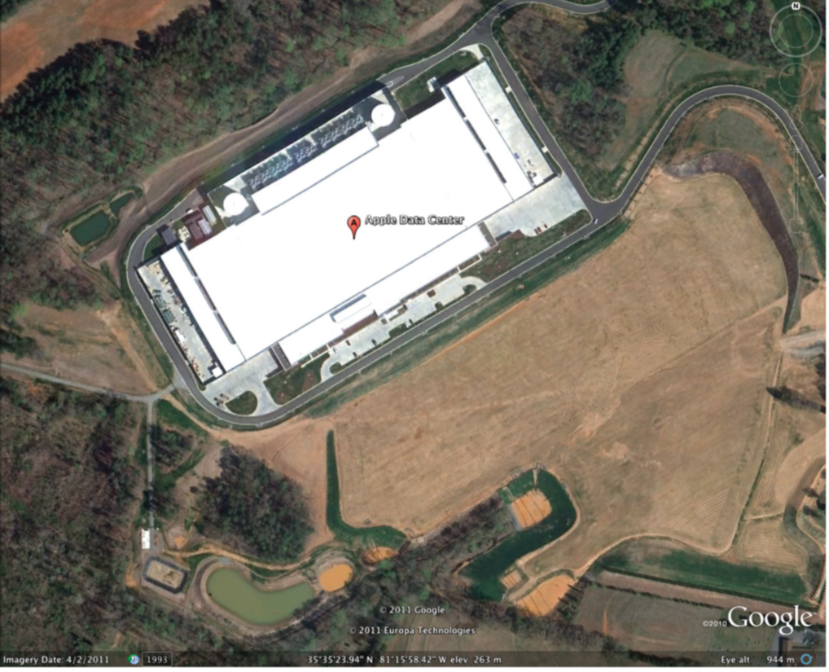
Apple Data Center in Maiden, N C
6-2 How do organizations use the cloud?
Billion-dollar facility contains more than 505,000 square. feet.
Figure 6-7 Apple Data Center in Maiden, N C
Source: Google Earth
Notes:
Constructed in 2011 to support its iCloud.
Amazon.com, IBM, Google, Microsoft, Oracle, and other large companies operate several similar farms worldwide.

Slide 19
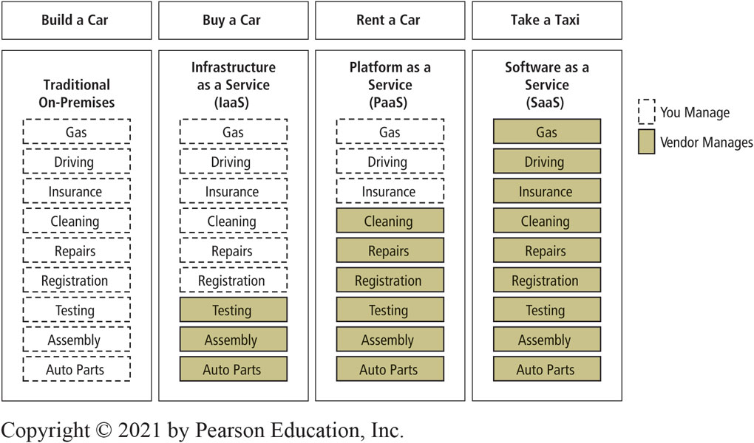
Transportation as a Service (Metaphor)
6-2 How do organizations use the cloud?
Figure 6-8 Transportation as a Service

Slide 20
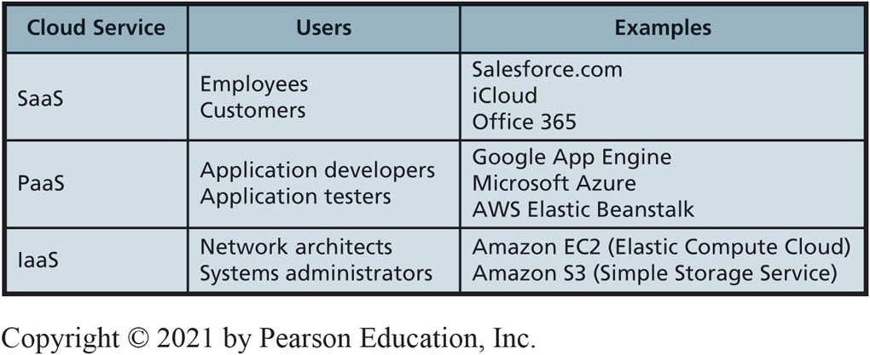
Types of Cloud Service Offerings
6-2 How do organizations use the cloud?
Figure 6-9 Three Fundamental Cloud Types
Notes:
Organizations can use the cloud in several different ways. By far most popular, is to obtain cloud services from cloud service vendors.

Slide 21
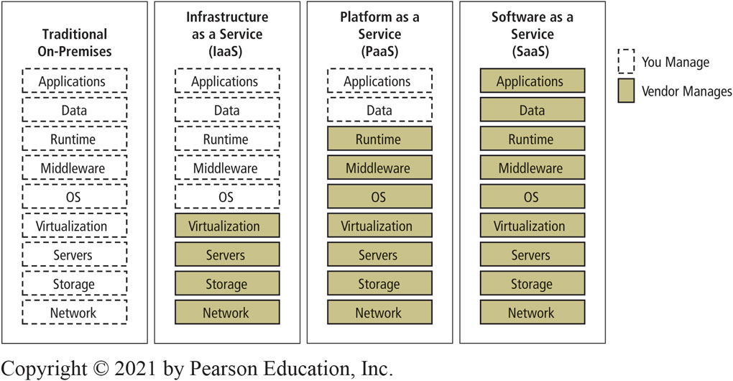
Comparison of Cloud Service Offerings
6-2 How do organizations use the cloud?
Figure 6-10 Cloud Service Offerings
Notes:
Figure 6-10 shows a comparison of cloud service offerings to traditional on-premises including Infrastructure as a Service, Platform as a Service, and Software as a Service.

Slide 22
Content Delivery Networks from Cloud Vendors
6-2 How do organizations use the cloud?
Content delivery network (C D N)
Stores user data in many different geographical locations and makes data available on demand.
Specialized type of P a a S, but usually considered in its own category.
Minimizes latency.
Used to store and deliver content seldom changed.

Slide 23
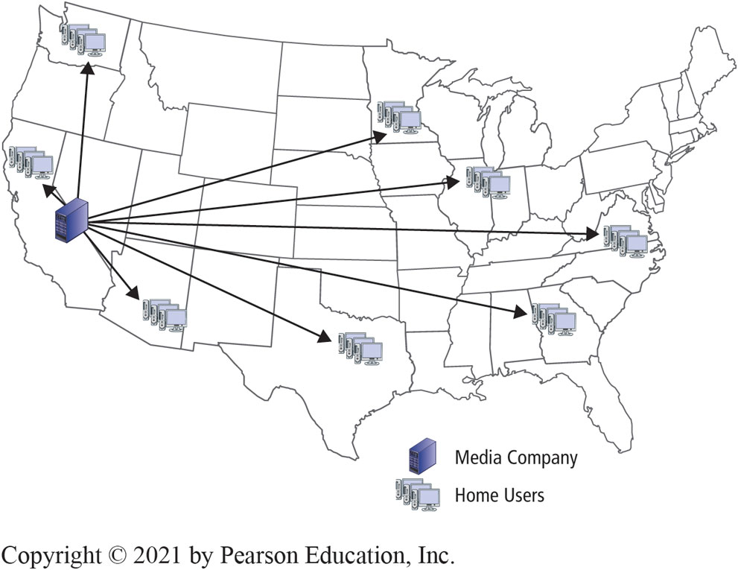
Traditional Server Content Distribution
6-2 How do organizations use the cloud?
Figure 6-11 Traditional Server Content Distribution
Notes:
Figure 6-11 shows traditional server content distribution.

Slide 24
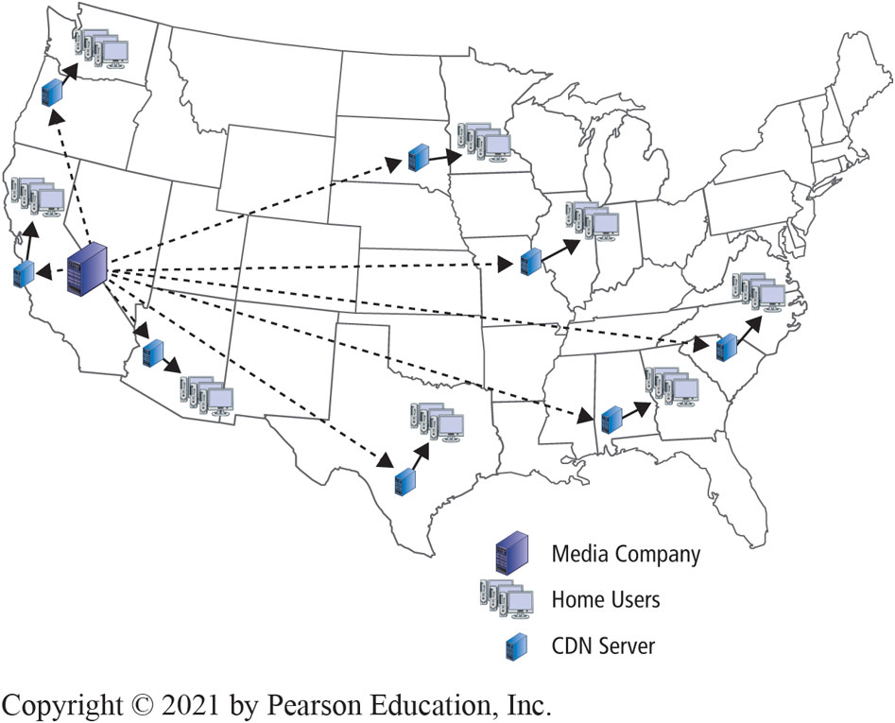
Distributed C D N Servers
6-2 How do organizations use the cloud?
Figure 6-12 Distributed C D N Servers
Notes:
Figure 6-12 shows distributed CDN servers distributing content. Note how much less content has to come directly from the source company. Local proximity of the CDN servers increases speed.

Slide 25
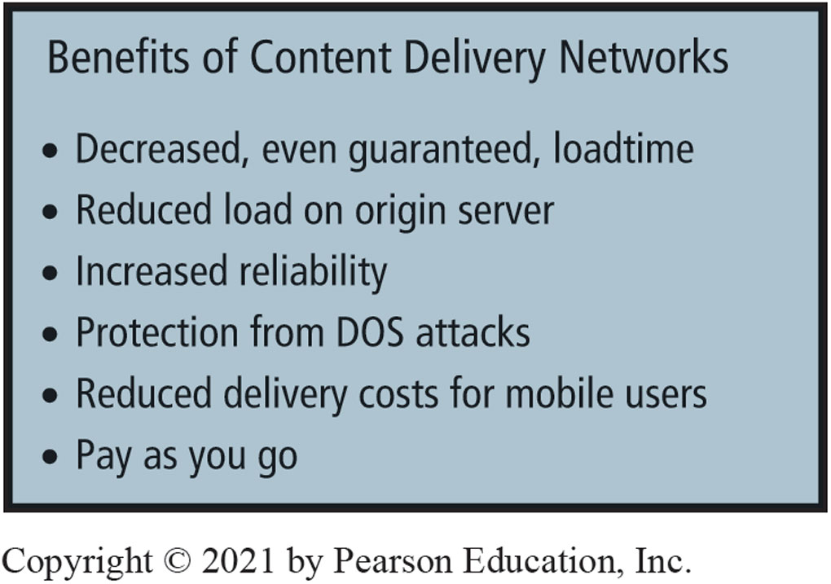
C D N Benefits
6-2 How do organizations use the cloud?
Figure 6-13 Benefits of Content Delivery Networks
Notes:
Figure 6-13 shows the benefits of content delivery networks.

Slide 26
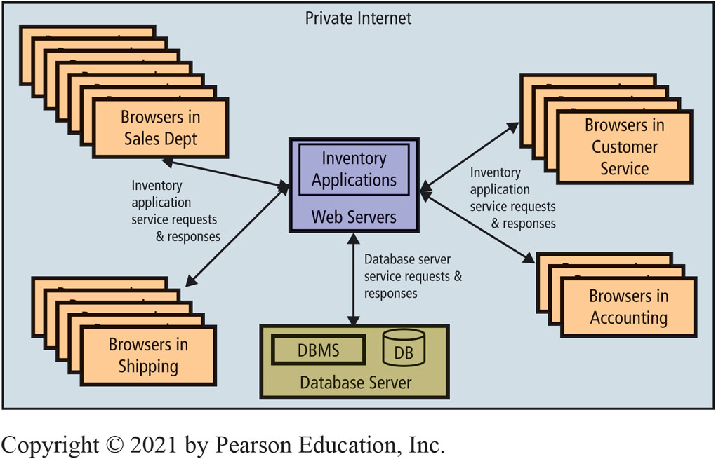
Using Web Services Internally
6-2 How do organizations use the cloud?
Figure 6-14 Web Services Principles Applied to Inventory Applications
Notes:
This figure shows a Web services inventory application at a hypothetical online bicycle part retailer named Best Bikes.
In this example, Best Bikes is running its own servers on its own infrastructure. To do so, Best Bikes sets up a private internet within the company, an internet that is generally not reachable from outside the company.
Best Bikes writes the applications for processing inventory using Web services standards; applications publish a WSDL; the Web services are accessed by other applications within the company using SOAP; and data are delivered using JSON.
Application users access the inventory Web services using JavaScript that is sent down to the users' browsers.

Slide 27
eHermes in the Cloud
6-3 How can eHermes use the cloud?
S a a S products eHermes could use.
Google Mail
Google Drive
Office 365
Salesforce.com
Microsoft C R M OnLine
many others…
Notes:
eHermes is a small company with a very small IT Department, and unlikely to have resources necessary to develop its own server infrastructure.

Slide 28
P a a S Services from Amazon D B M S Products with Elastic Cloud 2 (E C2)
6-3 How can eHermes use the cloud?
Amazon Aurora | A very fast MySQL relational database
Amazon DynamoDB | A fast and scalable No SQL database service
Amazon DocumentDB | A document database
Amazon ElastiCache | A very fast in-memory cache database service
Amazon Neptune | A fast fully-managed graph database for complex hierarchical structures
Amazon Quantum Ledger Database | A ledger database
Amazon Relational Database Service (RDS) | A relational database service supporting My SQL, Oracle, SQL Server, or PostgreSQL
Amazon Redshift | A petabyte-scale data warehouse
Amazon Timestream | A time series database
eHermes also could use CDN to distribute content worldwide and respond to leads generated from advertising.
Notes:
eHermes lease hardware and operating systems from cloud vendor.

Slide 29
I a a S Services at eHermes
6-3 How can eHermes use the cloud?
Provides basic hardware in the cloud.
May acquire servers to load operating systems.
Considerable technical expertise and management.
Alternative: Use elastic data storage services.
S a a S and P a a S provide more added value to eHermes.

Slide 30
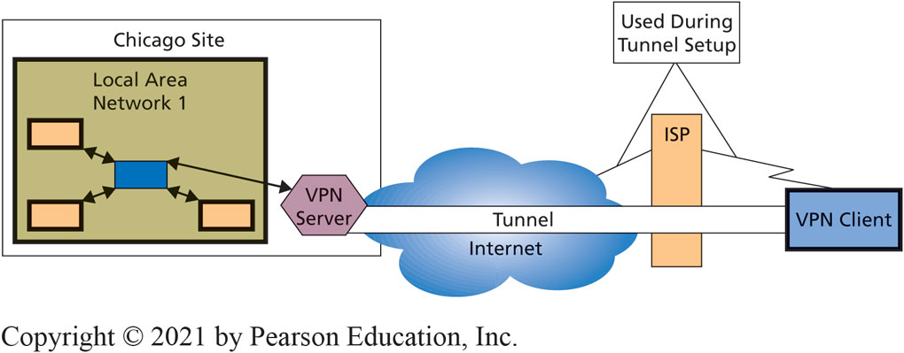
Organizations Using Cloud Services Securely
6-4 How can organizations use cloud services securely?
Figure 6-15 Remote Access Using V P N; Actual Connections
Notes:
Internet is a jungle of threats to data and computing infrastructure, as discussed in Chapter 10.
How can organizations realize the benefits of cloud technology without succumbing to those threats?
VPN technology uses public Internet to create appearance of a private connection on secure network.
Virtual means something that appears to exist but, in fact, does not.

Slide 31
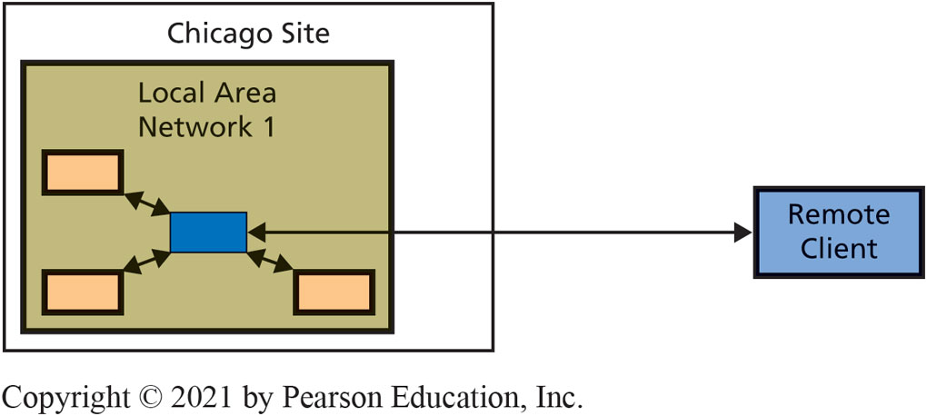
Remote Access Using V P N: Apparent Connection
6-4 How can organizations use cloud services securely?
Figure 6-16 Remote Access Using V P N; Apparent Connection
Notes:
This figure illustrates the connection as it appears to the remote user.
VPN client software encrypts messages so their contents are protected from snooping.
Then the VPN client appends the Internet address of the VPN server to the message and sends that package over the Internet to the VPN server.
When the VPN server receives the message, it strips its address off the front of the message, decrypts the coded message, and sends the plain text message to the original address inside the LAN.

Slide 32
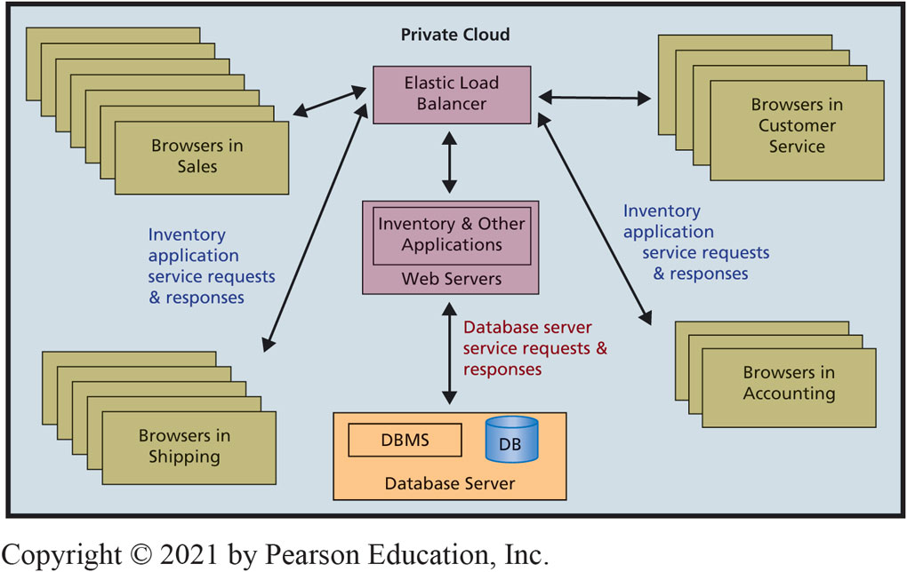
Private Cloud for Inventory and Other Applications
6-4 How can organizations use cloud services securely?
Figure 6-17 Private Cloud for Inventory and Other Applications
Notes:
To create a private cloud, the organization creates a private internet and designs applications using Web services standards.
In a server farm, the servers are managed by elastic load balancer devices.
Most organizations do not replicate database servers.

Slide 33
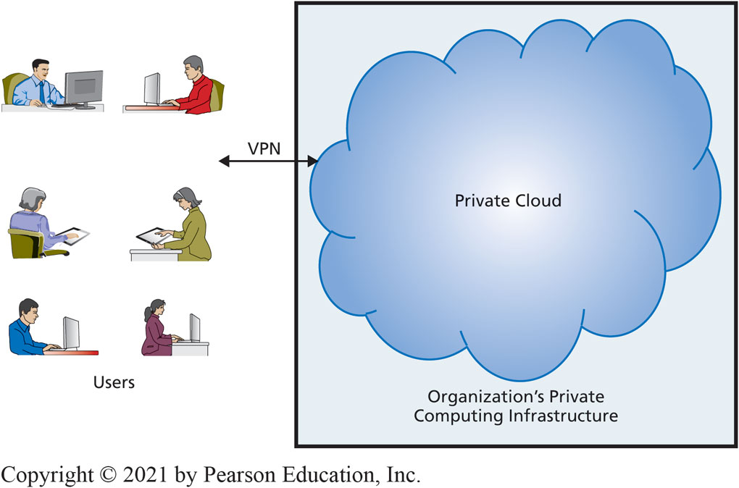
Accessing Private Cloud over a Virtual Private Network
6-4 How can organizations use cloud services securely?
Figure 6-18 Accessing Private Cloud over a Virtual Private Network
Notes:
Private clouds provide security within the organizational infrastructure but do not provide secure access from outside that infrastructure.
To provide such access, organizations set up a VPN and users employ it to securely access the private cloud.
Private clouds provide the advantages of elasticity, but to questionable benefit. What can organizations do with their idle servers?

Slide 34
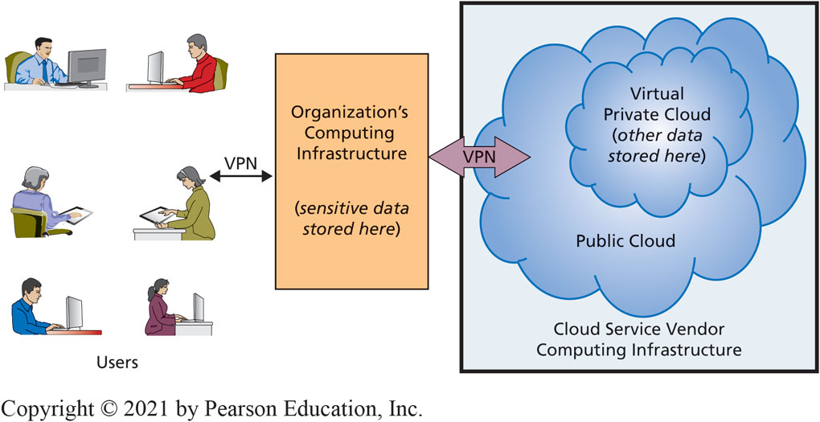
Using a Virtual Private Cloud
6-4 How can organizations use cloud services securely?
Subset of a Public Cloud With Highly Restricted, Secure Access
Figure 6-19 Using a Virtual Private Cloud (V P C)
Notes:
Organization can store most sensitive data on own infrastructure, and store less sensitive data on VPC. Thus, organizations required to have physical control over some of their data can place it on own servers and locate rest on VPC.

Slide 35
IRS Systems Overtaxed
So What?
Legacy systems can fail (Tax day 2018)
IRS had legacy system in place for processing tax payments (circa 1960s)
64% of current (2018) IRS systems considered aged
32% of software is multiple releases behind industry standards
IRS infrastructure is not cloud based
Should they consider a cloud-based solution?
Notes:
Is it time for you to upgrade either your phone or your laptop? If so, what are the indicators that you look for to determine whether your device is beginning to become unstable or fail? What other types of legacy systems have you encountered?
The IRS system crash of 2018 is the most recent example of a high-profile IT-infrastructure debacle with the U.S. government. Can you think of any other recent examples of government-related IT problems?
From a security perspective, what are the pros and cons of the government using such outdated IT systems for handling tax filings?
What types of interactions do you have with the cloud? Do you back up personal documents, like photos and music, on the cloud? Do you use it strictly for productivity-related files and collaboration? What are the benefits and drawbacks of the cloud for you relative to storing files locally on your devices?

Slide 36
How Will the Future Cloud Affect Me?
6-5 What does the cloud mean for your future?
Cloud services faster, more secure, easier to use, cheaper
Fewer organizations set up own computing infrastructure
More pooling of servers across organizations
Overall size of the cloud gets bigger
Individuals, small businesses, large organizations obtain elastic resources at very low cost
Cloud fosters new categories of work
Notes:
Absent some unknown factor such as a federal tax on Internet traffic.
Individuals on iCloud or Google Grid, to small groups using Office 365, to small companies like eHermes Parts using PaaS, to huge organizations using IaaS.

Slide 37
Future Cloud Services
6-5 What does the cloud mean for your future?
Remote action systems
Telemedicine
Telesurgery
Telelaw enforcement
Provide services in dangerous locations
Watch top-notch performers and performances
New cloud services
Analytics as a Service (A a a S)
Business Process as a Service (P B a a S)
Notes:
By enabling action at a distance, remote action systems save time and travel expense and make the skills and abilities of an expert available in places where he or she is not physically located. They also enable experts to scale their expertise.

Slide 38
How Does the Knowledge in This Chapter Help You?
6-5 What does the cloud mean for your future?
Cloud knowledge key for all business professionals in early years of career
Anticipate new categories of jobs you might find rewarding
Use of the clouds can potentially save your organization considerable money

Slide 39
Reverse Engineering Privacy
Ethics Guide
Digital billboards deliver targeted advertising
Location data transmitted by cell phones is sold by cell phone carriers to third parties.
Analysis of this data tells digital billboards what message to display throughout the day.
Is this a cool innovation?
Is this an egregious security concern?
Can we be confident that personally-identifiable information is removed?
Notes:
Goals
Alert students to:
Incredible profits can result from using the cloud.
Extreme profits for successful businesses.
Ethical issues of success and ethical considerations of wealthy.
What goes up can come down; level of profitability is probably not sustainable.
Discuss why cloud is a game changer (cheap communications, cheap servers, virtualization, sharing of hardware, Web standards).

Slide 40
Senior Network Manager
Career Guide
Rebecca Cengiz-Robbs at Carbonite
Q. What attracted you to this field?
A. “I was attracted to I T by the wide variety of disciplines and the abundant opportunities, especially for women. After working as a network administrator and being able to get exposure to storage, backups, computing, security, and networking, I realized I liked networking the best.”
Q. What advice would you give to someone who is considering working in your field?
A. “In addition to technical skills and a good work ethic, I’d develop emotional intelligence and build a personal network. Often in I T, it’s who you know and how you get along with people that will help you stand out and advance.”

Slide 41
Active Review
6-1 Why is the cloud the future for most organizations?
6-2 How do organizations use the cloud?
6-3 How can eHermes use the cloud?
6-4 How can organizations use cloud services securely?
6-5 What does the cloud mean for your future?

Slide 42
Salesforce.com
Case Study 6
Dominates market for CRM software
One of the highest valued cloud computing companies in the U.S.
Four pillars of success:
Trust
Growth
Innovation
Equality
Notes:
Explain how technology advancement affects legal requirements for preservation of financial data.

Slide 43

Copyright

